Slide 1
Lecture themes
Prototyping the physical design
Pathfinding (cont’d)

Slide 2

Prototyping the physical design

Slide 3
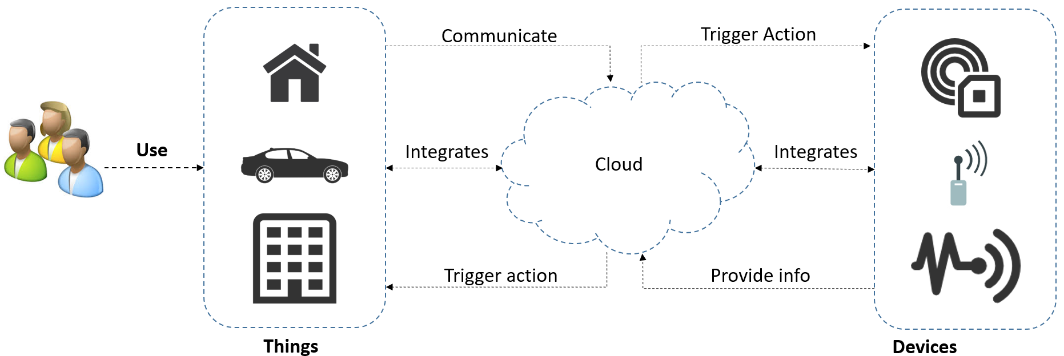
Physical design …
IoT design takes into count:
  Users
  Devices
  Sensors
  Things
  software, and
  Internet infrastructure

Slide 4




Physical design …
IoT involves many different disciplines:
  Software development
  Electronics
  UX design
  Product design

Slide 5

Physical design …
Product design is where most people choose simple solutions:
  Hackaday
  Kickstarter
  Physical packaging

Slide 6

Physical design …
Product design is a lot about being friendly to surroundings- people and the environment:
  Look at everything around you.
  Notice what you like and what you don't.
  Take notes until you end up with something relevant.

Slide 7
Physical design …
Another important task is to gain knowledge of the materials and their properties that you work with.
Example, the possibilities and limitations of the materials used in:
  3D printing
  Laser cutting of wood panels
  Milling of different materials, etc.

Slide 8
Physical design …
Thus, one must plan, sketch and test for what the product should look like before building the final physical thing.
So, write down notes on a whiteboard and build physical mockup.
Notes:
Mockup- a model or replica of a machine or structure, used for instructional or experimental purposes.

Slide 9

Design mockup- play dough
This is suitable for rapid form testing but not so for longer handling.

Slide 10
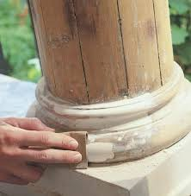
Design mockup- Epoxy putty
Epoxy putty is reminiscent of clay model but becomes rock hard over an hour.
It can then be- polished, painted, etc. and is well suited for lasting mockups.

Slide 11
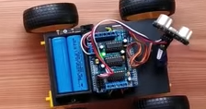
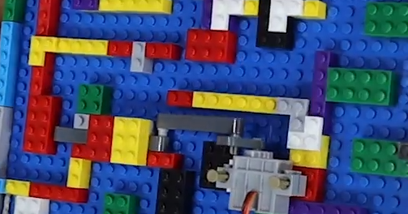
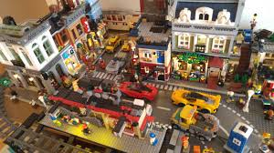
Design mockup- LEGO kits
LEGO kits such as meccano or similar solutions allow us to create mockups having moving parts.
In such models, it easy to reuse the components.
  How To Make A DIY Arduino Obstacle Avoiding Car At Home
  Build a Lego Maze with Arduino-Powered Gate

Slide 12

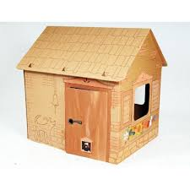
Design mockup- Papp
Papp is cardboard which is cheap and easy to work with.
The parts can later be used as templates for laser cutting of wooden boards, etc.

Slide 13
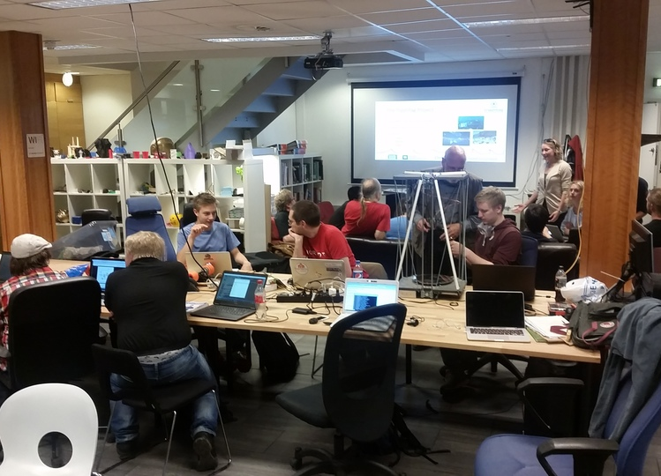
Makerspaces
It is a place in which people having related interests- share ideas, equipment, etc. especially in technology ...
Makerspaces can enable one interested to build IoT artifacts.
For example, you can try Bitraf in- 3D printer, laser cutter, CNC milling, electronics, etc.

Slide 14
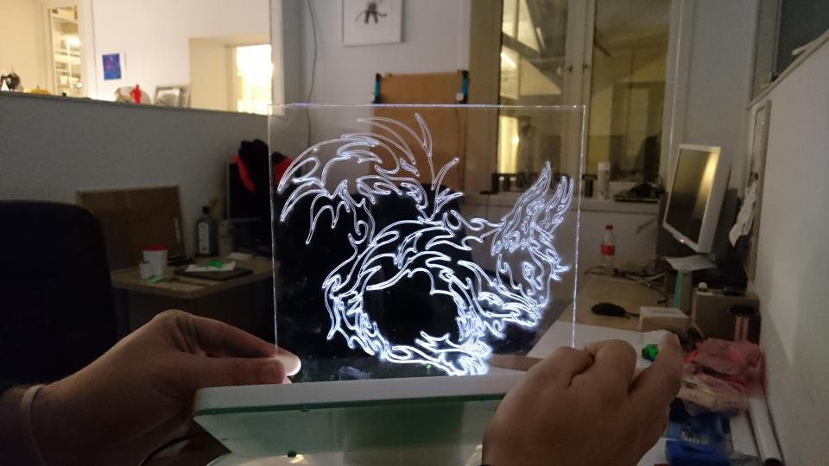
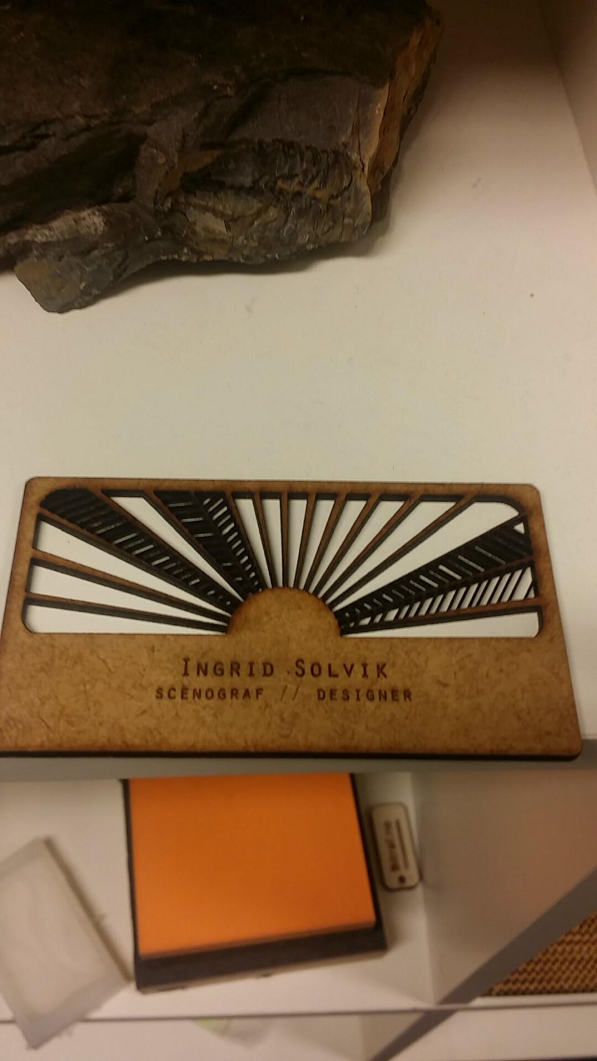
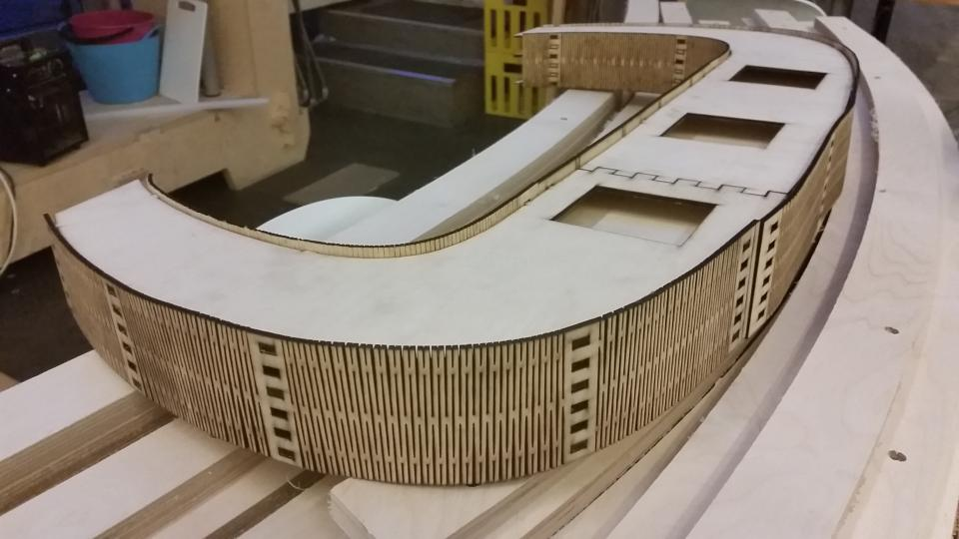
Laser cutting
Laser cutter is available for industrial and home use (less expensive) and takes materials like- leather, cloth, cardboard, felt, and wood.
It works by controlling the x and y directions and power of the laser beam- it can both etch and cut the materials- subtractive production.
=> it is easier to come up with good designs using the laser cutter.
More on leaser cutting
Source: bitraf.no/galleri
Notes:
Felt- a kind of cloth made by rolling and pressing wool or another suitable textile accompanied by the application of moisture or heat, which causes the constituent fibres to mat together to create a smooth surface. Source http://english.oxforddictionaries.com/felt

Slide 15
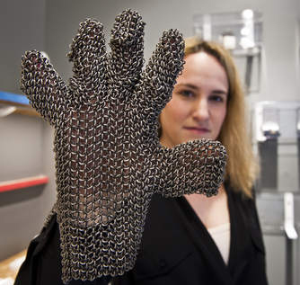
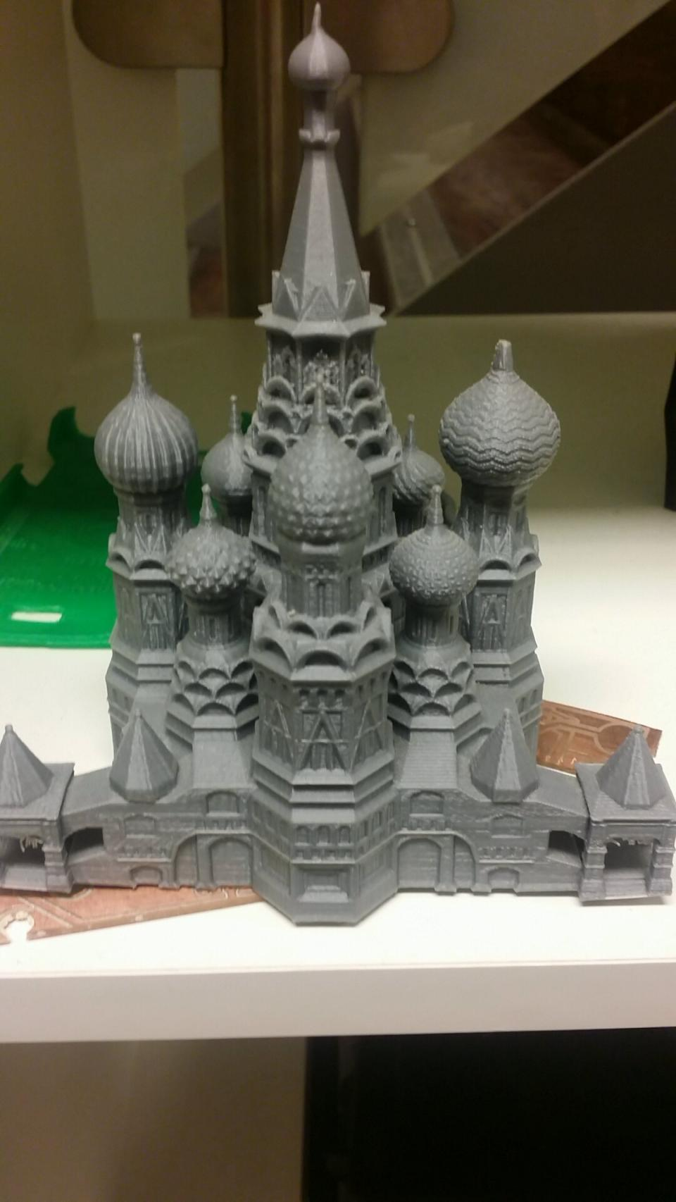
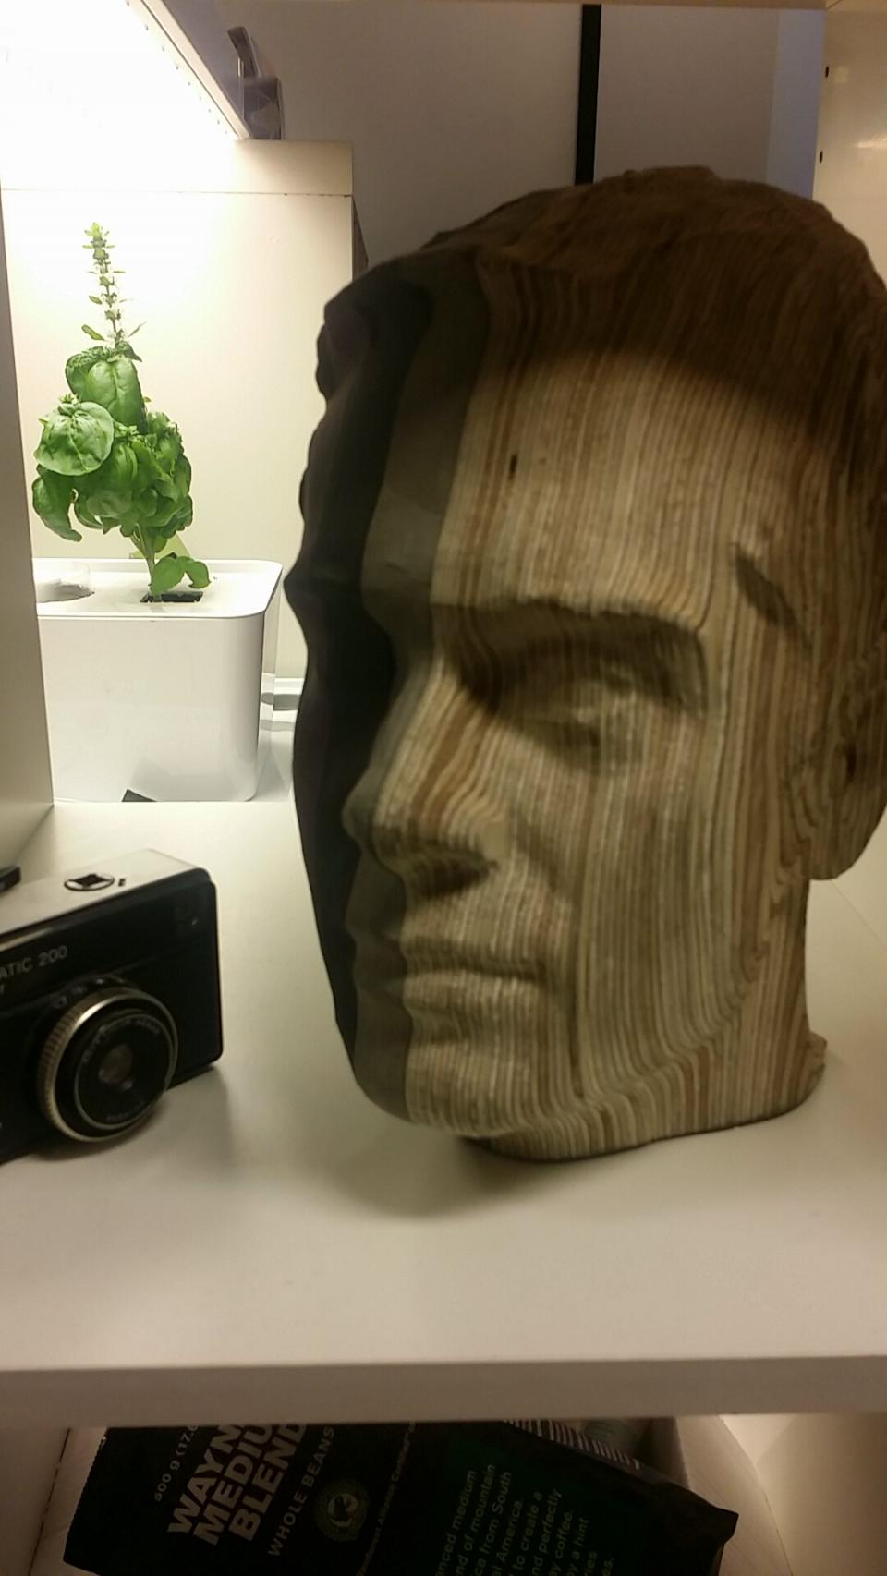
3D-printing
3D printing is a form for additive production that starts with nothing and build something together.
It enables to make parts like continuous rings or joints- that are not possible with other methods.
More on 3D printing
3D printed titanium armor | source: pcr-online.biz
Source: bitraf.no/galleri

Slide 16
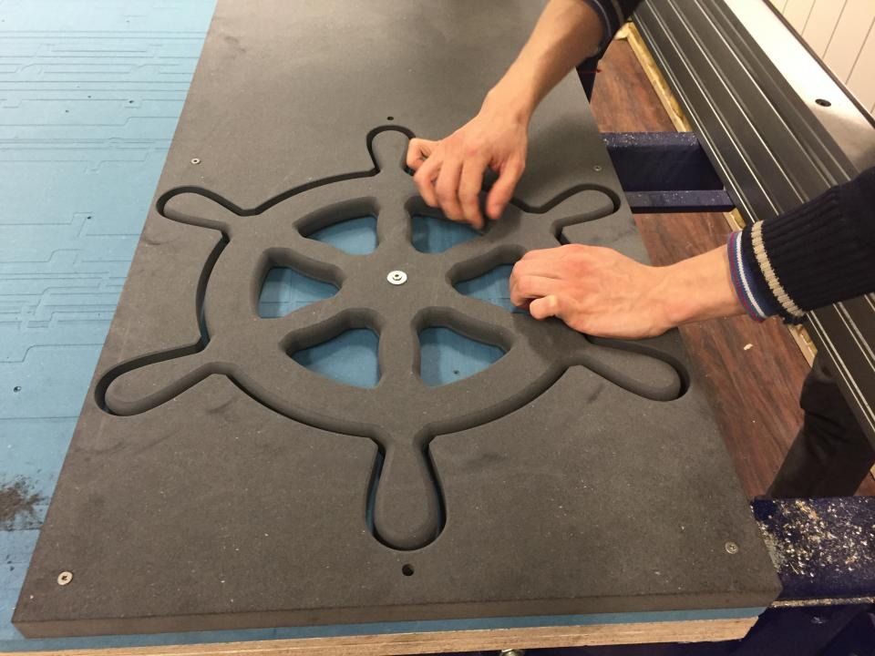
CNC milling
CNC milling is reminiscent of 3D printing, but is a subtractive production
  Starting with a material and removes unwanted parts- like a sculptor works.
  Since it is much easier to cut than assemble, CNC cutters can work with far more materials than 3D printers.
  For example, steel, wax, plastic, wood and aluminium are among the common materials used in CNC.
  More on CNC
Source: bitraf.no/galleri
Notes:
CNC = Computer Numerical Control

Slide 17

Path finding (cont’d)

Slide 18

Search algorithms
  Depth first and breadth first search algorithms (prev. lecture)
  Today, we focus on:
  Dijkstra's shortest path algorithm
  Best first search
  A* search
Notes:
Find 1 video and 1 article as a resource for the class
Prepare a 5-10 minute presentation

Slide 19
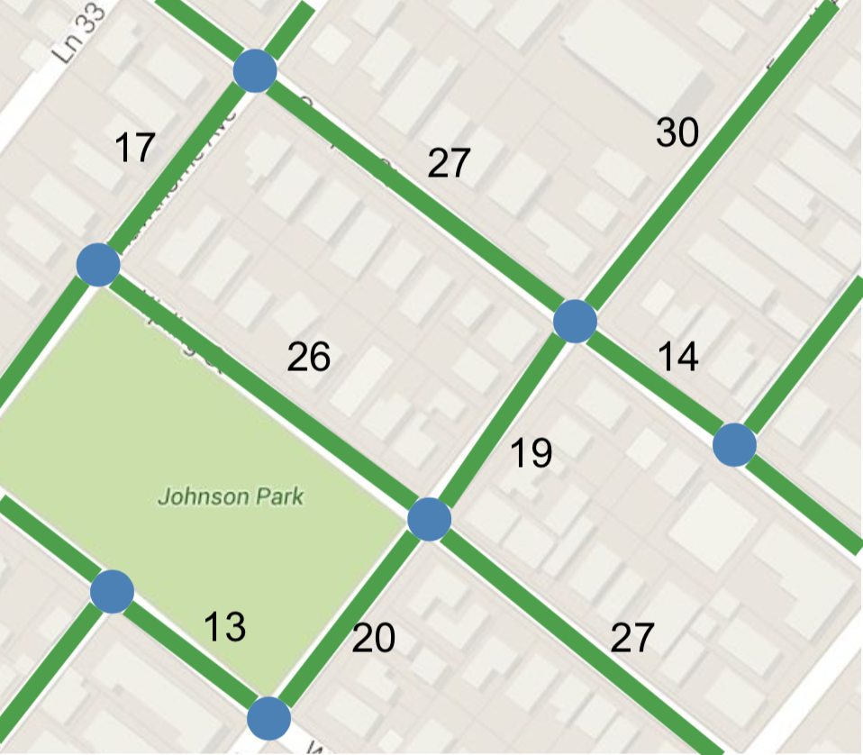
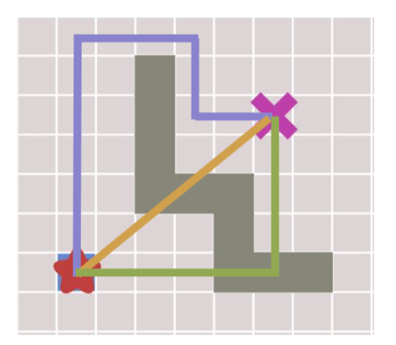
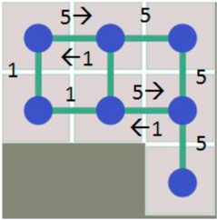
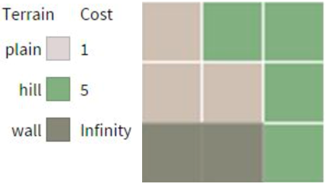
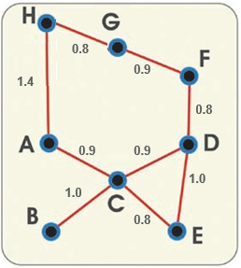
Path node definition
A
D
B
E
C
Notes:
Find 1 video and 1 article as a resource for the class
Prepare a 5-10 minute presentation

Slide 20
Dijkstra’s algorithm
Dijkstra's algorithm is a BFS with the following more functionality:
  It knows the distance between nodes and takes care of distance travelled from start node to current node.
  Items in the queue are prioritized (sorted) based on the shortest distance, and nodes previously visited are re-visited if the distance this time is shorter.
  Its advantage over BFS is that it always reaches a destination in the shortest path- not only in number of nodes but also in terms of cost/expense.

Slide 21
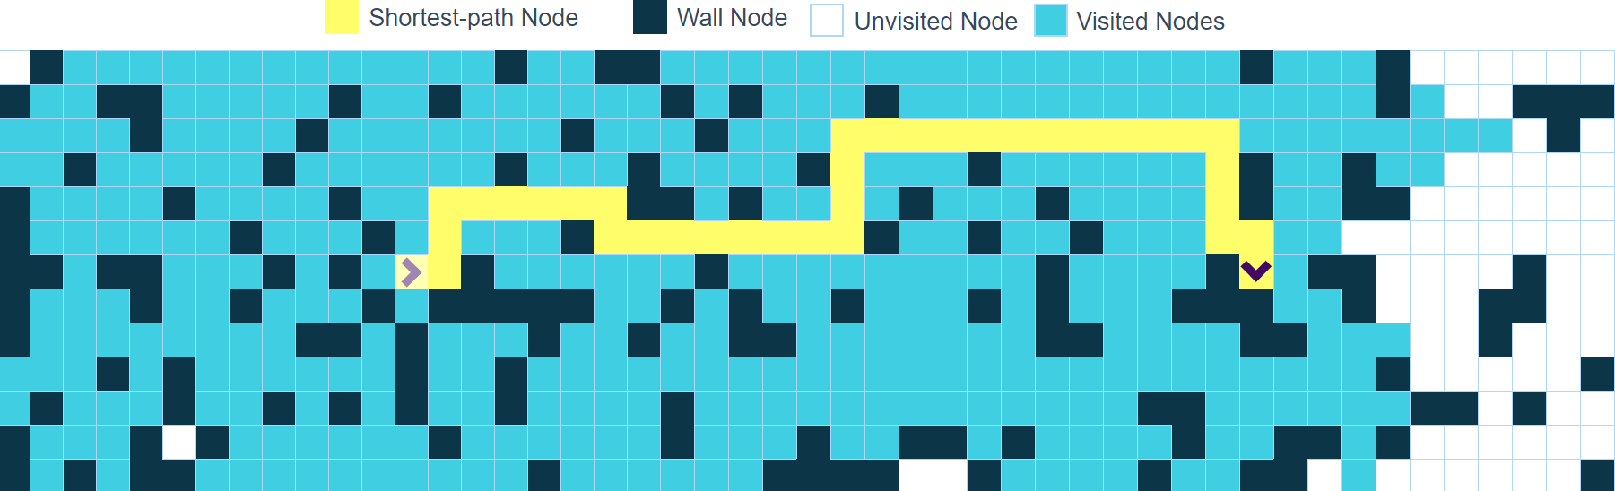
Dijkstra’s algorithm ...
Pseudo-code for Dijkstra's algorithm: (compared to BSD)
Startup: MARK all noder ”NOT visited”.
MARK startnode ”visited”. Set Distance = 0.0
ADD startnode to the queue (parent = itself).
WHILE (queue not empty)
  SET current = first from queue, DELETE.
  IF (current == target)
  TERMINATE with SUCCESS.
  FOR (each node connected current)
    IF (node NOT visited)
      MARK node ”visited”.
      node.Distance = current.Distance + ConDistance
      ADD node to queue (SET parent=current).
    ELSE
      IF (current.Distance + ConDistance < node.Distance)
      node.Distance = current.Distance + ConDistance
      UPDATE parent = current.
TERMINATE with FAILURE.
https://clementmihailescu.github.io/Pathfinding-Visualizer/#

Slide 22
Dijkstra’s algorithm ...
In summary, Dijkstra's algorithm meets the objectives (in bold) below:
  If a path exists, the algorithm must find it.
  If multiple paths exist, the algorithm must find the best one.
  If no path exists, the algorithm must return a negative response, do not apply forever.
  The algorithm must be efficient!

Slide 23
Dijkstra’s algorithm ...
In summary, …
  Dijkstra’s algorithm is sometimes suitable for pathfinding.
  However, this algorithm is not the most efficient one.
  More on Dijkstra’s algorithm

Slide 24
Best First Search
In best first search, a node is selected for expansion based on the result of a heuristic function f(n)- uses distance in its calculations:
  It uses each node’s estimated distance to the target instead of actual distance.
  The estimation of distance from the current node to the target can be performed using Euclidean or Manhattan distance.
  Best First has problems when there are "enclosing" obstacles between start and finish. So, it must "swing back" and finds not the shortest way anymore.

Slide 25
Best First Search ...
In summary, BF meets the objectives (in bold)
  If a path exists, the algorithm must find it.
  If multiple paths exist, the algorithm must find the best one. (struggles with enclosing obstacles.)
  If no path exists, the algorithm must return a negative response, not search forever.
  The algorithm must be effective!
So, BF is suitable when there are no enclosing obstacles along the way.

Slide 26
A* search
A* algorithm is a combination of Dijkstra's and Best First:
  It uses distance travelled so far like Dijkstra's algorithm.
  But, instead of prioritizing the queue only by distances travelled, it combines with estimated remaining distance (like in Best First Search).
Notes:
A* was created by Peter Hart, Nils Nilsson, and Beryram Raphael as part of the Shakey project, which had the aim of building a mobile robot that could plan its own actions.

Slide 27
A* search …
What A* Search Algorithm does is that at each step it picks the node according to a value f which is the sum of g and h. At each step it picks the node having the lowest and process it. That is, f(n)=g(n)+h(n) where n is a node in a graph.

Slide 28
A* search …
Small changes in variable names:
  The queue (the sorted list) is called open list.
  Nodes visited and leaving the queue are moved to the closed list (no sorting).
  The sum of nodes in open list and closed list constitute visited (no variable)
  More on A* search

Slide 29
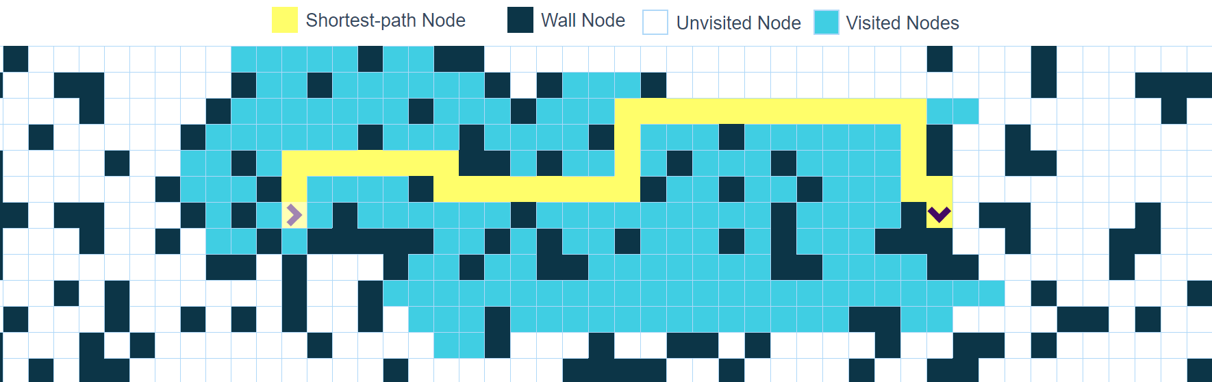
A* search …
Pseudo-code for A*:
Startup: MARK all nodes ”NOT visited”.
ADD startnode to open list, TraveledDistance = 0.0,
costings EstimatedRemaining.
WHILE (open list not empty)
  SET current = first from open list, DELETE.
  ADD current to closed list.
  IF (current == target)
  TERMINATE with SUCCESS.
  FOR (each node connected current ("neighbour"))
    Make A* distance calculations, set/update parent.
    # "Distance so far" + "estimated remaining distance" = "number value that
    open list is sorted by”
    Add to open list, update place in open list, or
    move from closed list to open list.
TERMINATE with FAILURE.

Slide 30
A* search …
In summary, A* meets all the 4 objectives!
  If a path exists, the algorithm must find it.
  If multiple paths exist, the algorithm must find the best one.
  If no path exists, the algorithm must return a negative response, not search forever.
  The algorithm must be effective!
  So, A* is very well suited for pathfinding!

Slide 31
A* with jump points
A* is effective, but it can be further optimized using A* jump points.
It requires that the cost between nodes kept equal for the entire map-
every node has the same cost to or from in each direction.
The advantage is that we can remove several potential search nodes, since we know in advance, they will not be optimal.
Notes:
See: harablog.wordpress.com/2011/09/07/jump-point-search/
In computer science, jump point search (JPS) is an optimization to the A* search algorithm for uniform-cost grids. It reduces symmetries in the search procedure by means of graph pruning, eliminating certain nodes in the grid based on assumptions that can be made about the current node's neighbors, as long as certain conditions relating to the grid are satisfied. As a result, the algorithm can consider long "jumps" along straight (horizontal, vertical and diagonal) lines in the grid, rather than the small steps from one grid position to the next that ordinary A* considers.
Jump point search preserves A*'s optimality, while potentially reducing its running time by an order of magnitude.

Slide 32
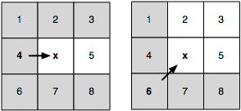
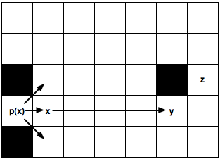
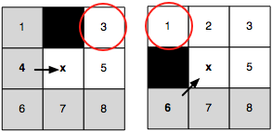
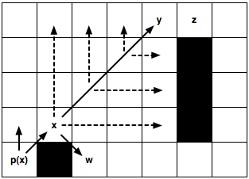
A* with jump points …
Without obstacles
Only stop at the points that qualify to be jump points (x, y, z).
Skip nodes until you reach a jump point or the edge of the area.
Before moving obliquely, follow the horizontal and vertical paths.
With obstacles
Remove gray neighbours from the search as they can be reachable from the parent of x.
Notes:
See: harablog.wordpress.com/2011/09/07/jump-point-search/
In computer science, jump point search (JPS) is an optimization to the A* search algorithm for uniform-cost grids. It reduces symmetries in the search procedure by means of graph pruning, eliminating certain nodes in the grid based on assumptions that can be made about the current node's neighbors, as long as certain conditions relating to the grid are satisfied. As a result, the algorithm can consider long "jumps" along straight (horizontal, vertical and diagonal) lines in the grid, rather than the small steps from one grid position to the next that ordinary A* considers.
Jump point search preserves A*'s optimality, while potentially reducing its running time by an order of magnitude.

Slide 33
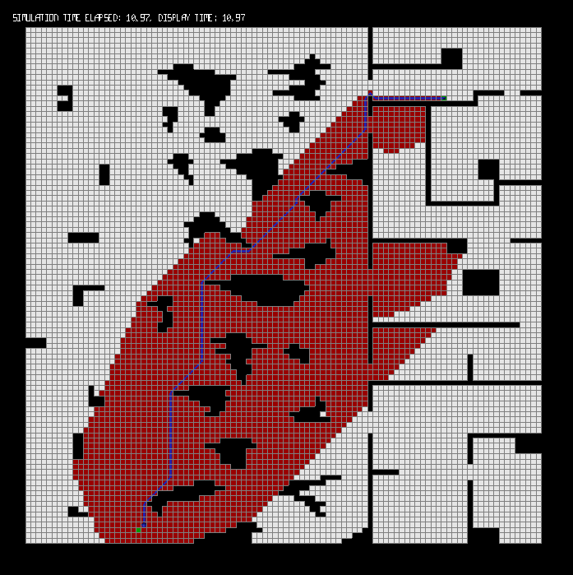
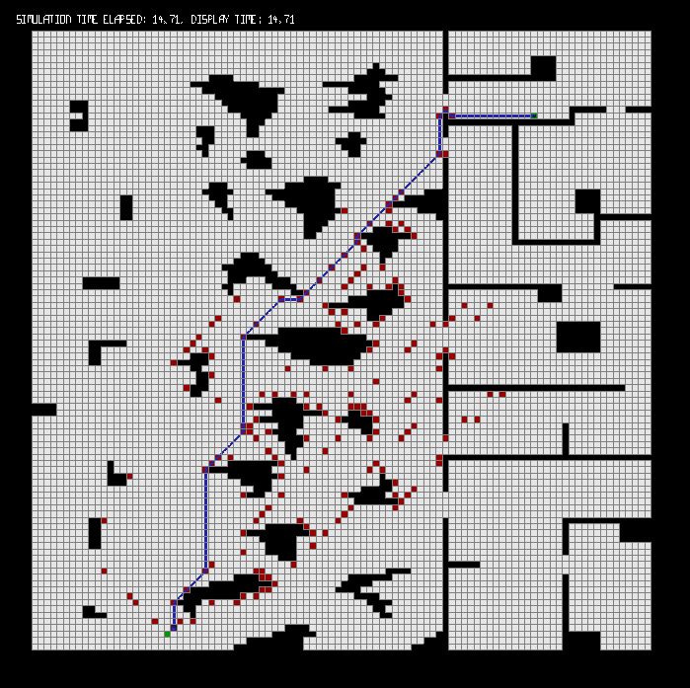
A* with jump points …
The figure below is a comparison of A* without and with jump points- with jumps being much faster than A*.
The effort needed (in red) in order to find the optimal path to the goal (blue)
More on this https://harablog.wordpress.com/2011/09/07/jump-point-search/
Notes:
See: harablog.wordpress.com/2011/09/07/jump-point-search/
In computer science, jump point search (JPS) is an optimization to the A* search algorithm for uniform-cost grids. It reduces symmetries in the search procedure by means of graph pruning, eliminating certain nodes in the grid based on assumptions that can be made about the current node's neighbors, as long as certain conditions relating to the grid are satisfied. As a result, the algorithm can consider long "jumps" along straight (horizontal, vertical and diagonal) lines in the grid, rather than the small steps from one grid position to the next that ordinary A* considers.
Jump point search preserves A*'s optimality, while potentially reducing its running time by an order of magnitude.

Slide 34
Mentimeter discussion points
Discuss on the importance of prototyping the physical design.
Describe any makerspaces that you have encountered before.
Describe 3D printing, Laser cutting and CNC milling.
(Week38) Compare and contrast DFS and BFS. Use the link below and discuss- https://clementmihailescu.github.io/Pathfinding-Visualizer/#
(Week38) What are the areas of applications DFS and BFS?
Compare Dijkstra’s, Best First and A* search algorithms in terms of meeting the objectives of pathfinding.

Slide 35
Next themes
Prototyping online components
Steering behaviors

